Slide 1

Python
Welcome
to python
telugu tutorials
The Software Services

Slide 2
Python
A brief Introduction to computers
The Software Services

Slide 3
Python
What is Computer ?
What is Hardware & software ?
What is Programming Language ?
The Software Services

Slide 4
What is a Computer ?
“A Computer is an electronic tool which is used to solve our day to day problems.”
Examples :
Solving Complex Mathematical Problems
DTP , Storing lots of Data
Business
Banking
Hospitals
Education
Scientific Research etc etc
The Software Services

Slide 5

Yours !
Veera Raghava
The Software Services

Slide 6
What is a Hardware ?
“Hardware refers to the electronic circuitary inside the computer which consists of various electronic components which works with electricity. These components are visible to eyes.”
Examples :
Resistors, Capacitors, Inductors, IC’s etc.
Input Devices (Keyboard, Mouse, Joystick, DVD Drive, Floppy, Pen Drive)
Processing Devices ( CPU, Memory)
Output Devices (Monitor, Printers, DVD Drive, Floppy, Pen Drive)
The Software Services

Slide 7
Yours !
Veera Raghava
The Software Services

Slide 8
What is a Software ?
“Software refers to the collection of various programs which makes Hardware to work according to our wish. These Software Programs are invisible to eyes but works behind the screens and makes things possible.”
Software is broadly sub divided into 2 types:
System Software (ex: OS such as Windows, Linux, Mac)
Application Software (ex: MS-Office, Video Player , Music Player etc)
What is a Program ?
“A Program is a preplanned sequence of instructions given to computer hardware to accomplish a specific task.This instructions are written in a Programming Language which follows its own Grammer rules, syntax and style.”
The Software Services

Slide 9
Yours !
Veera Raghava
The Software Services

Slide 10
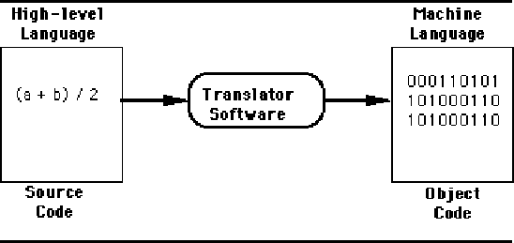
What is a Programming Language ?
The Software Services

Slide 11
Yours !
Veera Raghava
The Software Services

Slide 12
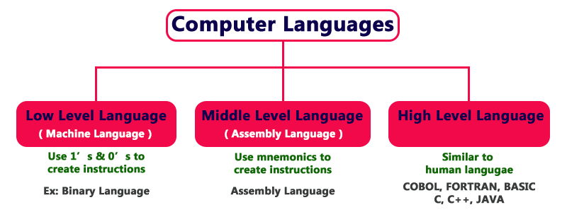
Levels of Programming Language ?
Python
The Software Services

Slide 13
Yours !
Veera Raghava
The Software Services

Slide 14
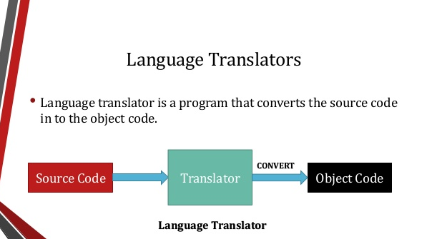
The Software Services

Slide 15
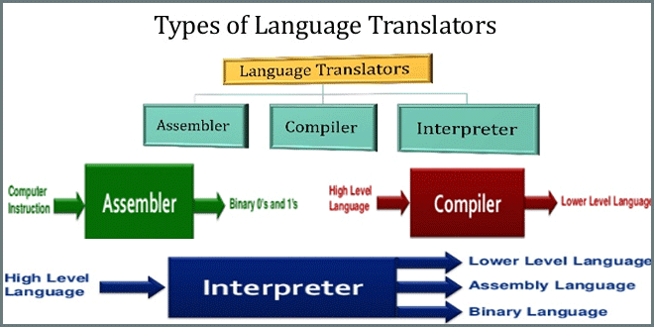
The Software Services

Slide 16
Yours !
Veera Raghava
The Software Services

Slide 17
Python
1. Python Introduction
2. Python features
The Software Services

Slide 18
Why Python, What is the Benefits of its use ? 1. Python code syntax is very readable and understandable 2. Application Development with python language is very fast 3. Python is a Developer Friendly Language
Python Introduction :
What is Python ?
1. Python is a High Level Programming Language 2. Python is a General Purpose Language 3. Python is an Intepreted Language 4. Python is a Very Dynamic and Powerful Language
5. Python is an Object Oriented Programming Language(OOP)
The Software Services

Slide 19
Python Features :
1) Easy to Learn and Use
2) Expressive Language
3) Interpreted Language
4) Cross-platform Language
5) Free and Open Source
6) Object-Oriented Language
7) Extensible
8) Large Standard Library
9) GUI Programming Support
10) Integrated
The Software Services

Slide 20
Yours !
Veera Raghava
The Software Services

Slide 21
Python
1. Python applications
2. Python versions
The Software Services

Slide 22
Python Applications :
1) Web Applications
a. Django
b. Flask
2) Desktop GUI Applications
a. PyQT
b. Tkinter
c. Kivy
3) General Purpose Applications
a. Scripting
b. Automation
c. Networking
4) Scientific, Data Science, ML & AI Applications
a. Numpy, b. Pandas, c. Matplotlib, d. Scikit-Learn
5) Business Applications
a. Trython
The Software Services

Slide 23
Python Versions :
Python language was developed by Guido Van Rassum in 1989 at Netherlands.
Gudo Van Rossum derived Python name from British comedy circus named ‘Monty Python’s Flying Circus’ which he likes very much
Gudo Van Rossum developed python to solve problems with his Amoeba Operating System.
Python is influenced by ABC Programming Language and Modula-3
The Software Services

Slide 24
Python 1.0 (January 1994) Python 2.0 (October 16, 2000) Python 2.7 (July 3, 2010) A major old version Python 3.7 (June 27, 2018) Present version which is widely used
Major Python Versions :
The Software Services

Slide 25
Yours !
Veera Raghava
The Software Services

Slide 26

The Software Services

Slide 27
Python Installation :
Open Python Official Web Site link www.python.org
Click on Downloads Tab on the home page top menu
Download the latest python version for your OS
Double click on downloaded installer package
The Software Services

Slide 28
Yours !
Veera Raghava
The Software Services

Slide 29
Pycharm IDE Installation :
Open jetbrains official web site www.jetbrains.com/pycharm
Download the Pycharm Community Edition (its Free)
Double click on downloaded installer package for installation
The Software Services

Slide 30
Yours !
Veera Raghava
The Software Services

Slide 31
What is an Algorithm :
“Algorithm is a step by step procedure to complete a given task”
Simple Addition Algorithm :
1-Step) Take 2 numbers say 10 and 20 as input.
2-Step) Store 10 in a Variable ‘x’
3-Step) Store 20 in a Variable ‘y’
4-Step) Add ‘x’ and ‘y’ (x+y)
5-Step) Store the Result (x+y) in a Variable ‘z’
6-Step) Print Variable ‘z’ to output to see the result.
The Software Services

Slide 32
Yours !
Veera Raghava
The Software Services

Slide 33
What is a Flow Chart :
“Flow Chart is a Graphical representation of an Algorithm”
Start
x = 10
y = 20
Input of two numbers
z = x + y
Addition process of two numbers
Print(z)
Output of addition result
Stop
The Software Services

Slide 34
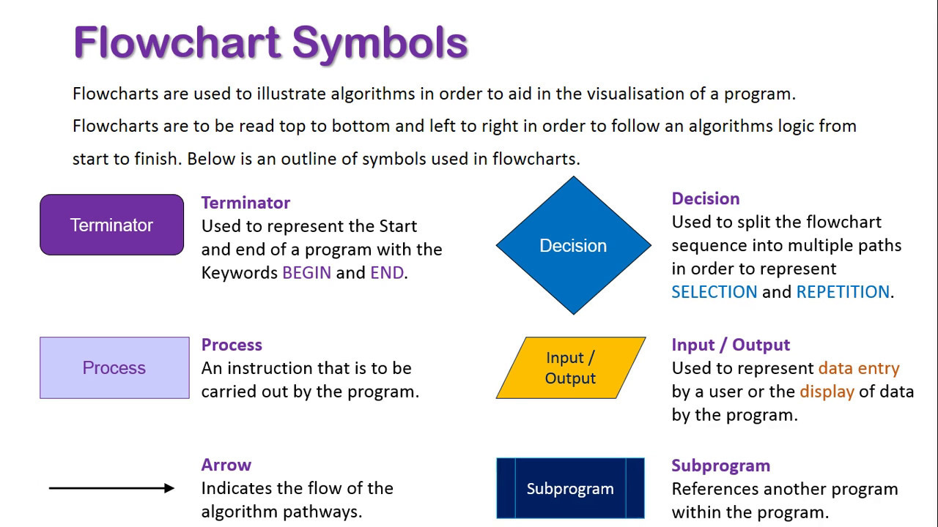
The Software Services

Slide 35
Yours !
Veera Raghava
The Software Services

Slide 36
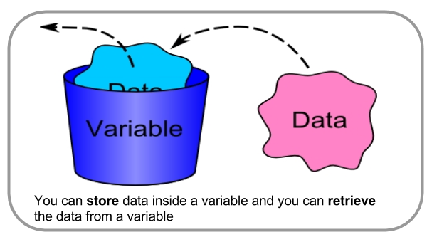
Python Variables
What is a Variable :
“A Variable is a name given to a memory location which stores
given data”
‘20’
‘20’
‘age’
The Software Services

Slide 37

 |  |  |  | COMPUTER MEMORY
 |  | Variable Name |  | age
 |  | Memory Address |  | 0X1A23FCBA
 |  | Data or Value |  | 20
The Software Services

Slide 38
Python Variable Naming Rules :
Rule-1) Python variable name should consists of one of or combination of ‘a to z’ or ‘A to Z’ or ‘ 0 to 9’ or ‘_’
Rule-2) First letter of a variable name must not contain a number
Rule-3) Should not use space or special character (!, @, #, %, ^, &, *, etc)
Rule-4) Should not use Python Keywords as variable names (if,else,for,while,break etc)
Rule-5) Python is case sensitive (Capital ‘A’ and Small ‘a’ are different)
The Software Services

Slide 39
Python Variable Declarations :
“Python is a Data Type infer language, hence no need to declare
variable type explicitly in advance, Python will automatically infer the
type of data given as input to variable.”
Ex : a = 10, no need to declare python variable as “ int a = 10 ”
Assigning Data to a Variable :
‘ = ‘ symbol is used to assign data to variable.
Assigning Single Value to Single Variable :
Ex : a = 10
Assigning Single Value to Multiple Variables :
Ex : a=b=c = 10
Assigning Multiple Values to Multiple Variable :
Ex : a,b,c = 10,20,30
The Software Services

Slide 40
Yours !
Veera Raghava
The Software Services

Slide 41
Python Variables
Ex: a = 10
Ex: b = 10
Ex: c = 10
 |  |  |  | COMPUTER MEMORY
 |  | Variable Name |  |  |  | a | b | c
 |  | Memory Address |  | 0X1A23FCBA |  | 0X1A23FC23 | 0X1A23FC65 | 0X1A23FC58
 |  | Data or Value |  | 10 |  | 10 | 10 | 10
a
b
c
The Software Services

Slide 42
Python Variables
Ex: a = 10
Ex: b = 20
Ex: c = 30
 |  |  |  | COMPUTER MEMORY
 |  | Variable Name
 |  | Memory Address |  | 0X1A23FCBA | 0X1A23FC59 | 0X1A23F745
 |  | Data or Value |  | 10 | 20 | 30
a
b
c
The Software Services

Slide 43
Python Comments :
Comments are user written words in a program which shows “purpose of the code”
Single line Comments :
‘#’ is used for single line comments
Multi line Comments:
‘‘‘ ’’’ or “ “ “ ” ” ” Three single quotes or Three double quotes are used
for Multi Line Comments
Python Indentation :
In Python, Indentation is used to represent a Block of Code instead of braces { }.
id = 25 id = 25
name = ‘narayana’ name = ‘narayana’
age = 40 age = 40
In Python, There is no need to put semi colon ; at the end of each statement.
The Software Services

Slide 44
Yours !
Veera Raghava
The Software Services

Slide 45
Python Data Types :
What is a Data Type :
“Data Type refers to different kinds of Data that can be assign to a Variable”
Different Data Types :
Number Ex : x = 10 (integer number) (mutable)
x = 20.5 (Float number) x = 2 + 5j (Complex number)
2. String Ex : name = ‘siva’ or “siva” or ‘ ’ ’ siva ’ ’ ’ or “ ” ” siva” ” ” (immutable)
3. List Ex : name = [ ‘sriram’ , ‘siva’ , ‘lalitha’ ] (mutable)
age = [ 9, 5, 3 ]
4. Tuple Ex: name = ( ‘sriram’ , ‘siva’ , ‘lalitha’ ) (immutable)
age = ( 9, 5, 3)
5. Dictionary Ex: name_age = { ‘sriram’:9 , ‘siva’:5 , ‘lalitha’:3 } (mutable)
6. Set Ex: months = { ‘jan’ , ‘feb’ , ‘mar’ , ‘apr } (mutable)
The Software Services

Slide 46
Yours !
Veera Raghava
The Software Services

Slide 47
Python Operators :
Operator is a symbol which indicates a particular operation between operands
Arithmetic operators ( + , - , * , / , % , // ,** )
Comparison operators ( == , != , > , < , >= , <= , <> )
Assignment Operators ( = , += , -=, *= , /= , %= , //= , **= )
Logical Operators ( and , or , not )
Bitwise Operators ( & , | , ~ , ^ , << , >> )
Membership Operators ( in , not in )
Identity Operators (is , is not )
The Software Services

Slide 48
Yours !
Veera Raghava
The Software Services

Slide 49
Python Arithmetic Operators :
Arithmetic operators are used to perform arithmetic operations between two operands.
Name | Operator | Description
Addition | + | a = 20, b = 10 , a + b = 30
Subtraction | - | a = 20, b = 10 , a - b = 10
Division | / | a = 20, b = 10 , a / b = 2 (quotient)
Multiplication | * | a = 20, b = 10 , a * b = 200
Remainder | % | a = 20, b = 10 , a % b = 0 (remainder)
Exponent | ** | a = 2 , a**2 = 4 (a to the power of 2)
Floor Division | // | a = 5 , b = 2, a // b = 2
The Software Services

Slide 50
Yours !
Veera Raghava
The Software Services

Slide 51
Python Comparison Operators :
Comparison operators are used to comparing the value of the two operands and returns boolean true or false
Name | Operator | Description
equal to | == | If the value of two operands is equal, then the condition becomes true.
not equal to | != | If the value of two operands is not equal then the condition becomes true.
less than or equal to | <= | If the first operand is less than or equal to the second operand, then the condition becomes true.
greater than or equal to | >= | If the first operand is greater than or equal to the second operand, then the condition becomes true.
not equal to | <> | If the value of two operands is not equal, then the condition becomes true.
greater than | > | If the first operand is greater than the second operand, then the condition becomes true.
Less than | < | If the first operand is less than the second operand, then the condition becomes true.
The Software Services

Slide 52
Yours !
Veera Raghava
The Software Services

Slide 53
Python Assignment Operators :
The assignment operators are used to assign a value to a variable
Operator | Description
= | It assigns the the value of the right expression to the left operand.
+= | a = 10, b = 20 , a += b will be equal to a = a + b and therefore, a = 30.
-= | a = 20, b = 10 , a -= b will be equal to a = a - b and therefore, a = 10.
*= | a = 10, b = 20 , a *= b will be equal to a = a * b and therefore, a = 200.
%= | a = 20, b = 10 , a %= b will be equal to a = a % b and therefore, a = 0.
**= | a = 4 , b =2 , a **= b will be equal to a = a**b i.e 4 ** 2 = 16 ,therefore a = 16.
//= | a = 4, b = 3 , a //= b will be equal to a = a // b, therefore a = 1.
The Software Services

Slide 54
Yours !
Veera Raghava
The Software Services

Slide 55
Python Logical Operators :
The logical operators are used to evaluate a given expression to True or False
Operator | Description
and | If both the expressions are true, then the condition will be true otherwise false. a = true, b = true , a and b = true.
or | If one of the expressions is true, then the condition will be true. a = true, b = false , a or b = true.
not | If an expression a = true then not (a) will be false and vice versa.
The Software Services

Slide 56
Yours !
Veera Raghava
The Software Services

Slide 57
Python Bitwise Operators :
Bitwise Operators are used to perform bit by bit operation among given operands
Operator | Description
& (binary and) | If both the bits at the same place in two operands are 1, then 1 is copied to the result. Otherwise, 0 is copied.
| (binary or) | The resulting bit will be 0 if both the bits are zero otherwise the resulting bit will be 1.
^ (binary xor) | The resulting bit will be 1 if both the bits are different otherwise the resulting bit will be 0.
~ (negation) | It calculates the negation of each bit of the operand, i.e., if the bit is 0, the resulting bit will be 1 and vice versa.
<< (left shift) | The left operand value is moved left by the number of bits present in the right operand.
>> (right shift) | The left operand is moved right by the number of bits present in the right operand.
The Software Services

Slide 58
Yours !
Veera Raghava
The Software Services

Slide 59
Python Membership Operators :
Membership operators are used to check whether given value exists or not in a List or Tuple, if the value exists in the data structure then returns true otherwise it returns false.
Operator | Description
in | It is evaluated to be true if the first operand is found in the second operand (list, tuple). a = 10 , b = [20,50,64,10] , a in b returns true.
not in | It is evaluated to be true if the first operand is not found in the second operand (list, tuple). a = 62 , b = [ 65,89,74,25,36] , a not in b returns true.
The Software Services

Slide 60
Yours !
Veera Raghava
The Software Services

Slide 61
Python Identity Operators :
Identity Operators are used to check the address reference of two variable is same or not.
Operator | Description
is | It is evaluated to be true if the reference present at both sides points to the same object. a = 10 , b = 10 , a is b returns true.
is not | It is evaluated to be true if the reference present at both side do not point to the same object. a = 10 , b = 20 a is not b returns true
The Software Services

Slide 62
Yours !
Veera Raghava
The Software Services

Slide 63
Python supports four different numerical types
Python Number Methods :
int | long | float | complex
10 | 51924361L | 0.0 | 3.14j
100 | -0x19323L | 15.20 | 45.j
-786 | 0122L | -21.9 | 9.322e-36j
Number System | Prefix
Binary | '0b' or '0B‘ ex: 0b1010 or 0B1010
Octal | '0o' or '0O‘ ex: 0o17 or 0O17
Hexadecimal | '0x' or '0X‘ ex: 0xFF or 0XFF
The Software Services

Slide 64
We can convert one type of number into another. This is also known as Type Conversion. Ex-1: a = 56 (integer data type) float(a) -> 56.0 complex(a) - > 56 + 0j Ex-2: a = 8.4 (float data type) int(a) -> 8 complex(a) - > 8.4 + 0j Ex-3: a = 2+5j (complex data type) int(a) -> (type error) float(a) - > (type error)
Python Type Conversion :
The Software Services

Slide 65
No. | Function or Method Description
1 | abs(x)The absolute value of x: the (positive) distance between x and zero. Ex: abs(-5) = 5
2 | ceil(x)The ceiling of x: the smallest integer not less than x Ex: ceil(5.8) = 6
3 | floor(x)The floor of x: the largest integer not greater than x Ex: floor(5.8) = 5
4 | max(x1, x2,...)The largest of its arguments: the value closest to positive infinity Ex: max(5,8,6,7,9) = 9
5 | min(x1, x2,...)The smallest of its arguments: the value closest to negative infinity Ex: min(5,8,6,7,9) = 6
6 | pow(x, y)The value of x**y. Ex : pow(2,3) = 8
7 | round(x [,n])x rounded to n digits from the decimal point. Python rounds away from zero as a tie-breaker: round(0.5) is 1.0 and round(-0.5) is -1.0. Ex: round(28.84762,2) = 28.84
8 | sqrt(x)The square root of x for x > 0 Ex: sqrt(4) = 2
The Software Services

Slide 66
Yours !
Veera Raghava
The Software Services

Slide 67
Python String Methods :
A group of characters enclosed in the quotes are called Strings.
In python String data types are enclosed in single quotes or double quotes or three single quotes or three double quotes.
Ex: name = ‘sriram’ or ‘‘sriram’’ or ‘‘‘sriram’’’
Ex: type(name) - > string data type
Strings are immutable
The Software Services

Slide 68
Operator | Description
+ | It is known as concatenation operator used to join the strings given either side of the operator.
* | It is known as repetition operator. It concatenates the multiple copies of the same string.
[ ] | It is known as slice operator. It is used to access the sub-strings of a particular string.
[ : ] | It is known as range slice operator. It is used to access the characters from the specified range.
in | It is known as membership operator. It returns if a particular sub-string is present in the specified string.
not in | It is also a membership operator and does the exact reverse of in. It returns true if a particular substring is not present in the specified string.
{ } | It is used as place holders for string formatting
% | It is used to perform string formatting. It makes use of the format specifiers used in C programming like %d or %f to map their values in python. We will discuss how formatting is done in python.
The Software Services

Slide 69
‘+’ symbol is used for String concatenation
Ex: firstname = ‘veera’
lastname = ‘raghava’
print(firstname + lastname) - > veeraraghava
‘*’ symbol is used for String Repetition
Ex: name = ‘siva’
print(name * 3)-> sivasivasiva
[ ] symbol is used for String indexing
Ex: name = ‘sriram’
name[0]->s
name[1]->r
name[2]->i
name[3]->r
name[4]->a
name[5]->m
The Software Services

Slide 70
[ : ] symbol is used for String slicing
Ex: name = ‘sriram’
name[1:4] ->rir
‘in’ or ‘not in’ Membership operators are used to know whether a particular pattern of characters present in a given string or not.
Ex: ‘ra’ in name->true
‘v’ not in name -> true
String Formating
Normal String Formating:
Ex : name = ‘sriram’
age = 9
height = 4.5
print(“My name is ” , name , “My age is ” , age, “My height is “ , height)
The Software Services

Slide 71
print(“My name is ” + name + “My age is ” + age + “My height is “ + height) 2) Using C-style String formaters (%d, %f, %s) : Ex: print(“ My name is %s My age is %d My height is %f ” % (name, age, height)) 3) Using Place Holders ( { } with format() ) : Ex: print(“ My name is { } My age is { } My height is { } ”.format(name,age,height))
The Software Services

Slide 72
Method | Description
find | It returns the index value of the string where substring is found between begin index and end index.
len(string) | It returns the length of a string.
lower() | It converts all the characters of a string to Lower case.
lstrip() | It removes all leading whitespaces of a string and can also be used to remove particular character from leading.
replace(old,new) | It replaces the old sequence of characters with the new sequence. The max characters are replaced if max is given.
rstrip() | It removes all trailing whitespace of a string and can also be used to remove particular character from trailing.
split() | Splits the string according to the delimiter str. The string splits according to the space if the delimiter is not provided. It returns the list of substring concatenated with the delimiter.
swapcase() | It inverts case of all characters in a string.
upper() | It converts all the characters of a string to Upper Case.
The Software Services

Slide 73
Yours !
Veera Raghava
The Software Services

Slide 74
A list can be defined as a collection of values or items of different types. The items in the list are separated with the comma (,) and enclosed with the square brackets [ ]. (Lists Data types are Mutable) Ex: lst = [4,3,6,9,45,74] Ex: lst = [‘siva’,56,8.4] List Indexing “[ ]”: Ex:lst = [58,64,89,74] lst[0]->58 lst[1]->64 lst[2]->89 lst[-1]->74 List Slicing “[ : ]” : Ex:lst = [6,8,7,4,1,2,9] lst[2:5]->[7,4,1]
Python List Methods :
The Software Services

Slide 75
Ex: lst = [75,85,35,48,96] lst[2] = 99 print(lst)
Inserting Data into List :
Deleting Data from List :
Ex: lst = [75,85,35,48,96] del lst[2] print(lst)
The Software Services

Slide 76
Operator | Description | Example
Repetition ‘ * ’ | The repetition operator enables the list elements to be repeated multiple times. | lst=[1,2,3,4] lst*2 = [1, 2, 3, 4, 1, 2, 3, 4]
Concatenation ‘ + ‘ | It concatenates the list mentioned on either side of the operator. | a = [1,2,3,4] b = [5,6,7,8] a+b = [1, 2, 3, 4, 5, 6, 7, 8]
Membership ‘in’ ‘not in’ | It returns true if a particular item exists in a particular list otherwise false. | print(2 in a) prints True.
Iteration | The for loop is used to iterate over the list elements. | for i in a: print(i) ->1 2 3 4
Length | It is used to get the length of the list | len(a) = 4
The Software Services

Slide 77
Some of List Built-in functions :
Function | Description
len(list) | It is used to calculate the length of the list.
max(list) | It returns the maximum element of the list.
min(list) | It returns the minimum element of the list.
list(seq) | It converts any sequence to the list.
The Software Services

Slide 78
Some of List Built-in Methods :
Function | Description
list.append() | The element represented by the object obj is added to the list.
list.clear() | It removes all the elements from the list.
list.copy() | It returns a shallow copy of the list.
list.count() | It returns the number of occurrences of the specified object in the list.
list.remove() | It removes the specified object from the list.
list.reverse() | It reverses the list.
list.sort() | It sorts the list by using the specified compare function if given.
The Software Services

Slide 79
Yours !
Veera Raghava
The Software Services

Slide 80
Python Tuple Methods :
A tuple can be written as the collection of comma-separated values enclosed with the small brackets. (Tuple Data types are immutable)
Ex: tp = (5,8,6,9)
Ex: tp = (69,’krishna’,5.9)
Tuple Indexing “[ ]”: Ex:tp = (58,64,89,74) tp[0]->58 tp[1]->64 tp[2]->89 tp[-1]->74 Tuple Slicing “[ : ]” : Ex:tp = (6,8,7,4,1,2,9) tp[2:5]->[7,4,1]
The Software Services

Slide 81
Inserting and updating tuple elements is not possible because tuple is immutable.
Operator | Description | Example
Repetition | The repetition operator enables the tuple elements to be repeated multiple times. | T1*2 = (1, 2, 3, 4, 5, 1, 2, 3, 4, 5)
Concatenation | It concatenates the tuple mentioned on either side of the operator. | T1+T2 = (1, 2, 3, 4, 5, 6, 7, 8, 9)
Membership | It returns true if a particular item exists in the tuple otherwise false. | print (2 in T1) prints True.
Iteration | The for loop is used to iterate over the tuple elements. | for i in T1: print(i)Output1 2 3 4 5
Length | It is used to get the length of the tuple. | len(T1) = 5
The Software Services

Slide 82
Function | Description
len(tuple) | It calculates the length of the tuple.
max(tuple) | It returns the maximum element of the tuple.
min(tuple) | It returns the minimum element of the tuple.
tuple(seq) | It converts the specified sequence to the tuple.
The Software Services

Slide 83
Yours !
Veera Raghava
The Software Services

Slide 84
Python Dictionary Methods :
Dictionary Data type is a Key-Value Pairs seperated by commas and enclosed with curly braces.
Ex: dt = {‘name’ : ‘krishna’ , ‘age’ : 25 , ‘salary’ : 40000 , ‘company’ : ‘microsoft’}
print(type(dt)) →dict
Accessing Dictionary Data :
Ex: Ex:
dt[‘name’]->krishna dt.keys
dt[‘age’]->25 dt.values
dt[‘salary’]->40000
dt[‘company’]->microsoft
Updating Dictionary Data :
Ex:
dt[‘name’] = ‘siva’
dt[‘age’] = 30
The Software Services

Slide 85
Deleting Dictionary Data :
Ex : del dt[‘name’]
Ex : del dt[‘age’]
Iterating Dictionary Data :
Ex: for i in dt:
print(i)
Ex: for i in dt.values:
print(i)
Ex: for x in dt.items:
print(x)
Ex: for x,y in dt.items:
print(x) or print(x,y)
print(y)
The Software Services

Slide 86
Method | Description
dict.clear() | It is used to delete all the items of the dictionary.
dict.copy() | It returns a shallow copy of the dictionary.
dict.items() | It returns all the key-value pairs as a tuple.
dict.keys() | It returns all the keys of the dictionary.
dict.update() | It updates the dictionary by adding the key-value pair of dict2 to this dictionary.
dict.values() | It returns all the values of the dictionary.
dict(sequence) for type conversion
Ex: lst = [[‘name’,’raghava’],[’work’,’it’]]→list of lists
dict(lst)
tp = ((‘name’,’raghava’),(‘work’,’it’))→tuple of tuples
dict(tp)
The Software Services

Slide 87
Yours !
Veera Raghava
The Software Services

Slide 88
Python Set Methods :
The set in python can be defined as the unordered collection of various items enclosed within the curly braces. The elements of the set can not be duplicate.
Unlike other collections in python, there is no index attached to the elements of the set, i.e., we cannot directly access any element of the set by the index. However, we can print them all together
Ex: Days = {"Monday", "Tuesday", "Wednesday", "Thursday", "Friday", "Saturday", "Sunday"}
print(type(Days))
Accessing Set Data :
Ex: print(Days)
Ex: for i in Days:
print(i)
The Software Services

Slide 89
Ex: Months = {"January","February", "March", "April", "May", "June“} Months.add("July") Months.add("August") print(Months) Ex: Months = {"January","February", "March", "April", "May", "June“} Months.update(["July“,”August”]) print(Months) Removing Set Data : Months.remove({"January“) print(Months)
Adding Set Data :
Adding more than one value to Set Data :
The Software Services

Slide 90
Union of Sets :
Ex:
Days1 = {"Monday","Tuesday","Wednesday","Thursday"}
Days2 = {"Friday","Saturday","Sunday"}
print(Days1 | Days2) # using or ‘ | ‘ operator
print(Days1.union(Days2)) # using union method
Intersection of Sets :
Ex:
set1 = {"Ayush","John", "David", "Martin"}
set2 = {"Steve","Milan","David", "Martin"}
print(set1&set2) # using and ‘&’ operator
print(set1.intersection(set2)) # using intersection method
Set() is used for type conversion
Ex: a = [1,2,3,6,8]
Set(a) - > {2,3,8,6,1}
Frozenset()-> is immutable set
Ex: b = frozenset(a), type(b)
The Software Services

Slide 91
Yours !
Veera Raghava
The Software Services

Slide 92
Nesting Lists,Tuples & Dictionaries :
Similar Data Structure Nesting :
1. List of Lists Ex: a = [ [1,2] , [3,4] , [5,6] ]
2. Tuple of Tuples Ex: a = ( (1,2) , (3,4) , (5,6) )
3. Dict of Dict’s Ex: a = { ‘name’:’siva’ , ‘age’:5 , ‘work’:{ ‘school’:’study’ , ’ground’:’playing’ } }
Disimilar Data Structure Nesting :
1. List of Tuples Ex: a = [ (1,2) , (3,4) , (5,6) ]
2. List of Dict’s Ex: a =[ { ‘name’:’sriram’ , ‘age’:9 } , {‘name’:’siva’,’age’:5} , {‘name’:’lalitha’,’age’:6}]
3. Tuple of Lists Ex: a = ( [1,2] , [3,4] , [5,6] )
4. Tuple of Dict’s Ex: a =( { ‘name’:’sriram’ , ‘age’:9 } , {‘name’:’siva’,’age’:5} , {‘name’:’lalitha’,’age’:6} )
5. Dict of Lists Ex: a = { ‘name’:[‘sriram’,’siva’,’lalitha’] , ’age’:[9,5,6] }
6. Dict of Tuples Ex: a = { ‘name’:(‘sriram’,’siva’,’lalitha’) , ’age’:(9,5,6) }
The Software Services

Slide 93
Similar Data Structure Nesting: 1. List of Lists Ex: a = [ [1,2] , [3,4] , [5,6] ] Single index or One-dimensional index accessing: print(a[0])→[1,2] print(a[1])→[3,4] print(a.[2])→[5,6] Double index or Two-dimensional index accessing: print(a[0][0])→1 print(a[0][1])→2 print(a[1][0])→3 print(a[1][1])→4 print(a[2][0])→5 print(a[2][1])→6
The Software Services

Slide 94
Similar Data Structure Nesting: 2. Tuple of Tuples Ex: a = ( (1,2) , (3,4) , (5,6) ) Single index or One-dimensional index accessing: print(a[0])→(1,2) print(a[1])→(3,4) print(a[2])→(5,6) Double index or Two-dimensional index accessing: print(a[0][0])→1 print(a[0][1])→2 print(a[1][0])→3 print(a[1][1])→4 print(a[2][0])→5 print(a[2][1])→6
The Software Services

Slide 95
Similar Data Structure Nesting: 3. Dict of Dict’s Ex: a = { ‘name’:’siva’ , ‘age’:5 , ‘work’:{ ‘school’:’study’ , ’ground’:’playing’ } } Single index or One-dimensional index accessing: print(a[‘name’])→siva print(a[‘age’])→5 print(a[‘work’])→ { ‘school’:’study’ , ’ground’:’playing’ } Double index or Two-dimensional index accessing: print(a[‘work’][‘school’])→study print(a[‘work’][‘ground’])→playing
The Software Services

Slide 96
Disimilar Data Structure Nesting: 1. List of Tuples Ex: a = [ (1,2) , (3,4) , (5,6) ] Single index or One-dimensional index accessing: print(a[0])→(1,2) print(a[1])→(3,4) print(a[2])→(5,6) Double index or Two-dimensional index accessing: print(a[0][0])→1 print(a[0][1])→2 print(a[1][0])→3 print(a[1][1])→4 print(a[2][0])→5 print(a[2][1])→6
The Software Services

Slide 97
Disimilar Data Structure Nesting: 2. List of Dict’s Ex: a =[ { ‘name’:’sriram’ , ‘age’:9 } , {‘name’:’siva’,’age’:5} , {‘name’:’lalitha’,’age’:6} ] Single index or One-dimensional index accessing: print(a[0])→ { ‘name’:’sriram’ , ‘age’:9 } print(a[1])→ {‘name’:’siva’,’age’:5} print(a[2])→ {‘name’:’lalitha’,’age’:6} Double index or Two-dimensional index accessing: print(a[0][‘name’])→sriram print(a[0][‘age’])→9 print(a[1][‘name’])→siva print(a[1][‘age’])→5 print(a[2][‘name’])→lalitha print(a[2][‘age’])→6
The Software Services

Slide 98
Disimilar Data Structure Nesting: 3. Tuple of Lists Ex: a = ( [1,2] , [3,4] , [5,6] ) Single index or One-dimensional index accessing: print(a[0])→(1,2) print(a[1])→(3,4) print(a[2])→(5,6) Double index or Two-dimensional index accessing: print(a[0][0])→1 print(a[0][1])→2 print(a[1][0])→3 print(a[1][1])→4 print(a[2][0])→5 print(a[2][1])→6
The Software Services

Slide 99
Disimilar Data Structure Nesting: 4. Tuple of Dict’s Ex: a =( { ‘name’:’sriram’ , ‘age’:9 } , {‘name’:’siva’,’age’:5} , {‘name’:’lalitha’,’age’:6} ) Single index or One-dimensional index accessing: print(a[0])→ { ‘name’:’sriram’ , ‘age’:9 } print(a[1])→ {‘name’:’siva’,’age’:5} print(a[2])→ {‘name’:’lalitha’,’age’:6} Double index or Two-dimensional index accessing: print(a[0][‘name’])→sriram print(a[0][‘age’])→9 print(a[1][‘name’])→siva print(a[1][‘age’])→5 print(a[2][‘name’])→lalitha print(a[2][‘age’])→6
The Software Services

Slide 100
Disimilar Data Structure Nesting: 1. Dict of Lists Ex: a = { ‘name’:[‘sriram’,’siva’,’lalitha’] , ’age’:[9,5,6] } Single index or One-dimensional index accessing: print(a[‘name’])→ [‘sriram’,’siva’,’lalitha’] print(a[‘age’])→ [9,5,6] Double index or Two-dimensional index accessing: print(a[‘name’][0])→sriram print(a[‘name’][1])→siva print(a[‘name’][2])→lalitha print(a[‘age’][0])→9 print(a[‘age’][1])→5 print(a[‘age’][2])→6
The Software Services

Slide 101
Disimilar Data Structure Nesting: 1. Dict of Tuples Ex: a = { ‘name’:(‘sriram’,’siva’,’lalitha’) , ’age’:(9,5,6) } Single index or One-dimensional index accessing: print(a[‘name’])→ (‘sriram’,’siva’,’lalitha’) print(a[‘age’])→ (9,5,6) Double index or Two-dimensional index accessing: print(a[‘name’][0])→sriram print(a[‘name’][1])→siva print(a[‘name’][2])→lalitha print(a[‘age’][0])→9 print(a[‘age’][1])→5 print(a[‘age’][2])→6
The Software Services

Slide 102
Yours !
Veera Raghava
The Software Services

Slide 103
Steps to Develop a Program :
TASK : Know the Task Clearly (Objective or Target)
ALGORITHM : Write an Algorithm to complete the Task
CODING : Write program code as per algorithm
EXECUTE : Execute the program
DEBUG : If any error comes Debug the code until we get a desired Result
PRODUCTION : Deploy the program in the real time production environment
The Software Services

Slide 104
Yours !
Veera Raghava
The Software Services

Slide 105
Write a Program to calculate the result of (a+b) * (a-b) [ Number data type ]
1. Task : find the result of (a+b) * (a-b)
2. Algorithm :
step-1) define two variables a,b and assign 2 values to each variable
step-2) add a & b and store result in variable x
step-3) subtract b from a and store result in variable y
step-4) mutliply x * y and store result in variable ‘result’
step-5) print the ‘result’ variable
step-6) task complete.
3. Coding :
a = 8
b = 2
x = (a + b)
y = (a – b)
result = x * y
print(result)
4. Execute : Execute the code
5. Debug : if error comes, debug the code
6. Production : Deploy the program into production
The Software Services

Slide 106
Yours !
Veera Raghava
The Software Services

Slide 107
Write a Program to concatenate two strings firstname & lastname [ String data type ]
1. Task : Concatenate two strings firstname and lastname
2. Algorithm :
step-1) define two variables firstname,lastname and assign 2 strings to each variable
step-2) concatenate two strings using ‘+’ and store result in variable fullname
step-3) print (fullname)
3. Coding :
firstname = ‘sri’
lastname = ‘ram’
fullname = firstname + lastname
print(fullname)
4. Execute : Execute the code
5. Debug : if error comes, debug the code
6. Production : Deploy the program into production
The Software Services

Slide 108
Yours !
Veera Raghava
The Software Services

Slide 109
Write a Program to repeat existing List elements by 2 times [ List data type ]
1. Task : Repetition of List elements by 2
2. Algorithm :
step-1) define a list with some data elements and store in a variable ‘lst’
step-2) use ‘*’ to repeat the elements in lst by 2 (lst*2) and store result in variable ‘result’
step-3) print (result)
3. Coding :
lst= [7,8,9]
result = lst*2
print(result)
4. Execute : Execute the code
5. Debug : if error comes, debug the code
6. Production : Deploy the program into production
The Software Services

Slide 110
Yours !
Veera Raghava
The Software Services

Slide 111
Write a Program to display tuple elements using indexing [ Tuple data type ]
1. Task : Display of Tuple elements using indexing.
2. Algorithm :
step-1) define a tuple with some data elements and store in a variable ‘tp’
step-2) use ‘[ ]’ indexing operator to display elements as tp[ 0 ] tp[ 1 ] etc
step-3) print (tp[0]) print(tp[1]) etc
3. Coding :
tp= (7,8,9)
print(tp[0])
print(tp[1])
print(tp[2])
print(tp[3])
4. Execute : Execute the code
5. Debug : if error comes, debug the code
6. Production : Deploy the program into production
The Software Services

Slide 112
Yours !
Veera Raghava
The Software Services

Slide 113
Write a Program to display Dict elements using key indexing [ Dictionary data type ]
1. Task : Display of Dictionary elements using key indexing.
2. Algorithm :
step-1) define a dict with some data elements along with keys and store in a variable ‘dct’
step-2) use ‘[‘key name’ ]’ key indexing operator to display elements as dct[ ‘key1’ ] etc
step-3) print (dct[‘key1’]) print(dct[‘key2’]) etc
3. Coding :
dct = { ‘fruit’ : ‘apple’ , ‘color’ : ‘red’ }
print(dct[‘fruit’])
print(dct[‘color’])
4. Execute : Execute the code
5. Debug : if error comes, debug the code
6. Production : Deploy the program into production
The Software Services

Slide 114
Yours !
Veera Raghava
The Software Services

Slide 115
Python Decision Making :
Decision Making is the process of taking decisions based on outcome of certain conditions.
If the condition is true then python interpreter will decide to execute specified code block and if the condition is false then python interpreter will execute another code block.
Types of Decision Making Statements :
IF
IF ELSE
Nested IF ELIF ELSE
The Software Services

Slide 116
Yours !
Veera Raghava
The Software Services

Slide 117
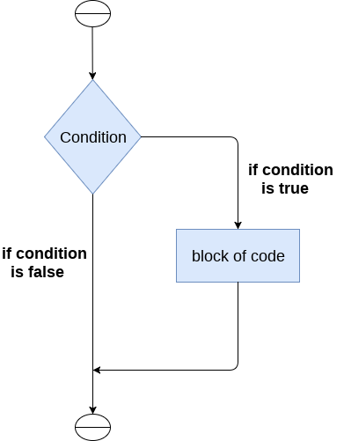
Python IF Statement :
IF statement is used to test a specific condition. If the condition is true, IF-block code will be executed. If condition is false then it does not execute (IF block code) it simply execute next statements.
SYNTAX:
if (expression):
block of statements
Next Statements
The Software Services

Slide 118
Ex : Program to find even number
num = int(input(“Enter the Number :”)
If (num%2 == 0):
print(“number is even”)
Print(“hello”)
Print(“how are you”)
Ex: Program to find largest number among 3 given numbers
num1 = int(input(“Enter first number”))
num2 = int(input(“Enter second number”))
num3 = int(input(“Enter third number”))
If ( (num1 > num 2) and (num1 > num3) ):
print(“largest number is :“, num1)
If ( (num2 > num 1) and (num2 > num3) ):
print(“largest number is :“, num2)
If ( (num3 > num 1) and (num3 > num2) ):
print(“largest number is :“, num3)
Print(“this code section will always execute irrespective of if condition”)
The Software Services

Slide 119
Yours !
Veera Raghava
The Software Services

Slide 120
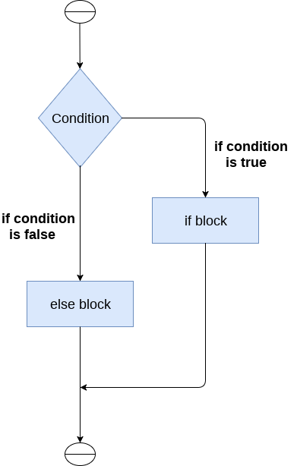
Python IF-ELSE Statement :
IF-Else statement is used to test a specific condition. If the condition is true, IF-block code will be executed and If the condition is false then Else-block code is executed.
SYNTAX :
if (condition):
block of statements
else:
block of statements
Next Statements
The Software Services

Slide 121
Ex: Program to check whether a person is eligible to vote or not
age = int (input("Enter your age : "))
if (age>=18):
print("You are eligible to vote")
else:
print(“You are not eligible to vote")
Ex: Program to check whether a number is even or not
num = int(input("enter the number :"))
if (num%2) == 0:
print(“Given number is Even")
else:
print(“Given number is Odd”)
The Software Services

Slide 122
Yours !
Veera Raghava
The Software Services

Slide 123
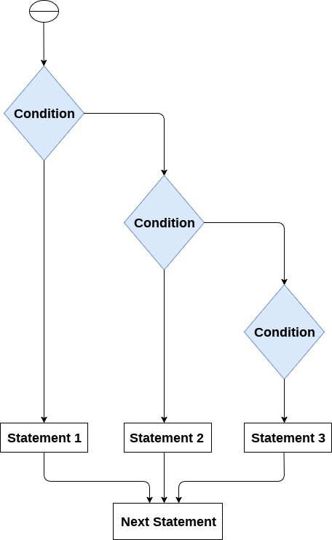
Python IF-ELIF-ELSE Statement :
IF-ELIF-ELSE statement is used to check multiple conditions and execute the specific block of statements depending upon the true condition among them.
SYNTAX :
if expression 1:
block of statements
elif expression 2:
block of statements
elif expression 3:
block of statements
else:
block of statements
The Software Services

Slide 124
Ex: Program to find Grade of student in Exams
marks = int(input("Enter the marks "))
if (marks > 85 and marks <= 100) :
print(“A-Grade”)
elif (marks > 60 and marks <= 85) :
print(“B-Grade”)
elif marks > 35 and marks <= 60:
print(“C-Grade”)
else:
print(“Fail")
The Software Services

Slide 125
Yours !
Veera Raghava
The Software Services

Slide 126
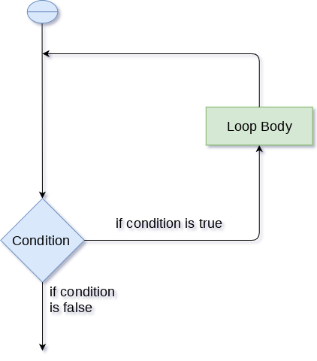
Python Loops :
Loop statements are used to execute the code again and again until certain condition is true.
Types of Loops in Python :
FOR Loop
2. While Loop
Advantages of Loop Statements :
Avoid code repetition
2. Traversing elements of Lists,Tuples or Dict’s
Next Statements
The Software Services

Slide 127
Python FOR Loop :
FOR loop is frequently used to traverse elements in a list or tuple or dictionary. FOR loop keeps on executing the given code until the specified sequence(range or lists or tuple or dict’s) exhaust’s.
SYNTAX:
for iterating_variable in sequence:
block of statements
Ex : Write a Program to print numbers from 1 to 100.
Sol-1) for i in range(1,100): or Sol-2) print(1)
print(i) print(2) 100 times.
The Software Services

Slide 128
Ex : Write a Program to print elements of a List.
Sol-1) or Sol-2) print(lst[0])
print(lst[1])
lst = [5,8.6,6,’siva’,2,4] print(lst[2])
print(lst[3])
for i in lst: print(lst[4])
print(i)
Ex : Write a Program to print elements of a Tuple.
Sol-1) or Sol-2) print(tp[0])
print(tp[1])
tp = (5,8.6,6,’siva’,2,4) print(tp[2])
print(tp[3])
for i in tp: print(tp[4])
print(i)
The Software Services

Slide 129
Ex : Write a Program to print elements of a Dictionary.
dct = { ‘name’:’siva’ , ‘age’:5 , ‘school’:’study’ , ’ground’:’playing’ }
Sol-1) or Sol-2) print(dct[‘name’])
for i in dct: print(dct[‘age’])
print(i) print(dct[‘school’])
print(dct[‘ground’])
for i in dct.values():
print(i)
for i in dct.items():
print(i)
for i,j in dct.items(): print(i,j)
The Software Services

Slide 130
Ex : Write a Program to print Multiplication Table.
Sol-1) or Sol-2) print(“5*1=“,5*1)
print((“5*2=“,5*2)
num = int(input(“Enter the number :”) print((“5*3=“,5*3)
print((“5*4=“,5*4)
for i in range(1,11): print("{ } X { } = { }".format(num,i,num*i))
or
print("%d X %d = %d“ %(num,i,num*i))
The Software Services

Slide 131
Yours !
Veera Raghava
The Software Services

Slide 132
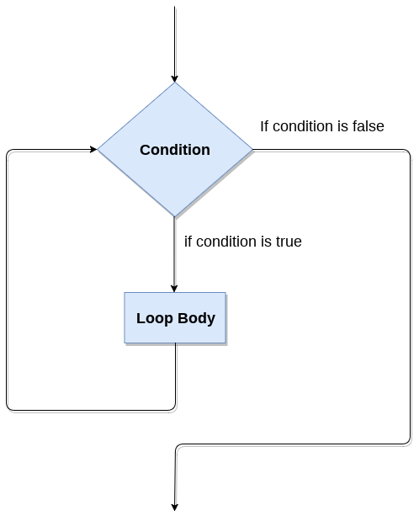
Python WHILE Loop :
WHILE Loop is used to execute the given code continuosly until its specified condition becomes true.
SYNTAX :
while expression:
statements
Ex : Write a Program to print numbers from 1 to 100.
Sol-1) i = 1
while (i<=100):
print(i)
i = i +1
Next Statements
The Software Services

Slide 133
Ex : Write a Program to print your name for 100 times
Sol-1) i = 1
while (i<=100):
print(“My name is Billa”)
i = i +1
print(“task completed”)
Ex : Write a Program to print Multiplication Table
Sol-1) num = int(input(“Enter a number :”))
i = 1
while (i<=10):
print("{ } X { } = { }".format(num,i,num*i))
i = i +1
print(“task completed”)
The Software Services

Slide 134
Infinite while loop :
If the condition given in the while loop never becomes false then the while loop will never terminate and result into the infinite while loop.
Ex : while (1):
print(“hello”)
Infinite While loop is used in situations where we need to take continuos input from the user.
Ex : while (True): name = input('Enter your name :\n') print('hello',name,'Have a nice day')
The Software Services

Slide 135
Yours !
Veera Raghava
The Software Services

Slide 136
Python Break Statement :
Break statement is used to break the loop prematurely and get out of Loop.
Ex: 1
for i in range(1,11):
if (i==5):
break
print(i)
print("came out of for loop")
Ex: 3
i = 0
while (1):
print(i)
i=i+1
if (i == 10):
break
print("came out of while loop")
Ex: 2
name = “krishna”
for i in name:
if (i==‘n’):
break
print(i)
print("came out of for loop")
The Software Services

Slide 137
Ex: Write a program to print Multiplication table and prompt to stop or proceed for another table.
for x in range(1,11): for i in range(1,11): print('{} X {} = {}'.format(x,i,x*i)) choice = input('continue for next table ‘yes’ or ‘no’ ? :') if (choice == 'no'): print('user chooses no,hence stopped next table') break
The Software Services

Slide 138
Yours !
Veera Raghava
The Software Services

Slide 139
Python Continue Statement :
Continue Statement is used to skip the current iteration and proceed for next iteration
Ex: 1
for i in range(1,11):
if (i==5):
continue
print(i)
print(“main line statement")
Ex: 2
name = “krishna”
for i in name:
if (i==‘n’):
continue
print(i)
print(“main line statement")
Ex: 3
i = 0
while (1):
print(i)
i=i+1
if (i == 10):
continue
print(“main line statement")
Python Pass Statement :
Pass Statement does not do anything.it is used for syntactical support for a program.
Ex: for i in range(1,100):
pass
The Software Services

Slide 140
Yours !
Veera Raghava
The Software Services

Slide 141
Python Functions:
A function is an organized block of reusable code with a specific name, which can be called whenever required.
Input
Ex: def add():
result = 10+20
return(result)
SYNTAX:
def function_name(arguments):
block of statements
return (expression)
Ex: def add():
result = 10+20
print(result)
Process
Advantages of Functions
Code Reuse
Modularity
Better Debugging
Output
The Software Services

Slide 142
Yours !
Veera Raghava
The Software Services

Slide 143
Functions with Arguments:
Input
SYNTAX:
def function_name(arguments):
block of statements
return (expression)
Ex: def add():
result = 10+20
return(result)
Input Arguments
a & b
Process
Ex: def add(a,b):
print(‘a =‘,a)
print(‘b =‘,b)
result = a+b
return(result)
x = add(4,8)
print(x)
Output
Types of Arguments:
1. Positional Arguments
2. Keyword Arguments
3. Default Arguments
4. Variable Length Arguments
The Software Services

Slide 144
Positional Arguments
Ex: def add(a,b):
print(“a = “,a)
print(“b =“,b)
result = a+b
return(result)
x = add(4,5)
print(x)
Keyword Arguments
Ex: def add(a,b):
print(“a = “,a)
print(“b =“,b)
result = a+b
return(result)
x = add(a=4 , b=5) or add(b=5 , a=4) or add(4,b=5) or add(a=4,5)
print(x)
The Software Services

Slide 145
3. Default Arguments
Ex: def add(a,b = 10):
print(“a = “,a)
print(“b =“,b)
result = a+b
return(result)
x = add(4) or add(4,7) or add(a=4) or add(a=4 , b=12) or add(b=20)
print(x)
4. Variable Length Arguments
Ex: def add(*numbers): result = 0 for i in numbers: result = result + i return(result) x = add(4,2) or add(5,8,9,6) print(x)
The Software Services

Slide 146
Yours !
Veera Raghava
The Software Services

Slide 147
Scope of Variables :
Scope of the variables depend upon the location where the variable is being declared. The variable declared in one part of the program may not be accessible to the other parts.In python, the variables are defined with two types of scopes.They are:
Global Scope or Global Variable : A variable declared outside of a function is called as “Global Variable”.
Ex: wish = “good morning” # Global variable declared outside of a function
def greet():
print(wish) # accessing wish variable inside a function is also possible
print(wish) # accessing wish variable outside of function is also possible
2. Local Scope or Local Variable : A variable declared inside a function is called as “Local Variable”.
Ex: def greet():
wish = “good morning” # Local variable declared inside a function
print(wish) # accessing wish variable is only possible inside a fucntion
print(wish) # accessing wish variable outside of function is not possible. Raises error.
The Software Services

Slide 148
Yours !
Veera Raghava
The Software Services

Slide 149
Call by Value :
Generally, In Call by Value method of calling function, the value of the variable passed as arguments will be copied to function dummy variables (argument names) in a different memory location and the changes to the data will not be reflected back to original variable.
In Python, the passed value as argument to a function is pointed by both original variable and dummy variable at the same memory location and if the function try to modify the value then a new object will be created in different memory location and the function dummy variable is now pointed to newly created modified object. Hence, the original variable will be unchanged by function modifications.
Python acts as Call by Value if passed data is immutable data types like numbers and string.
The Software Services

Slide 150
Ex:-1 Ex:-2
def test(b): # b = 20 def test(b): # b = “hello”
b = b+1 b = b + “ how are u ?”
print(b) print(b)
a = 20 # int data type immutable a = “hello” # string data type immutable
test(a) test(a)
print(a) print(a)
The Software Services

Slide 151
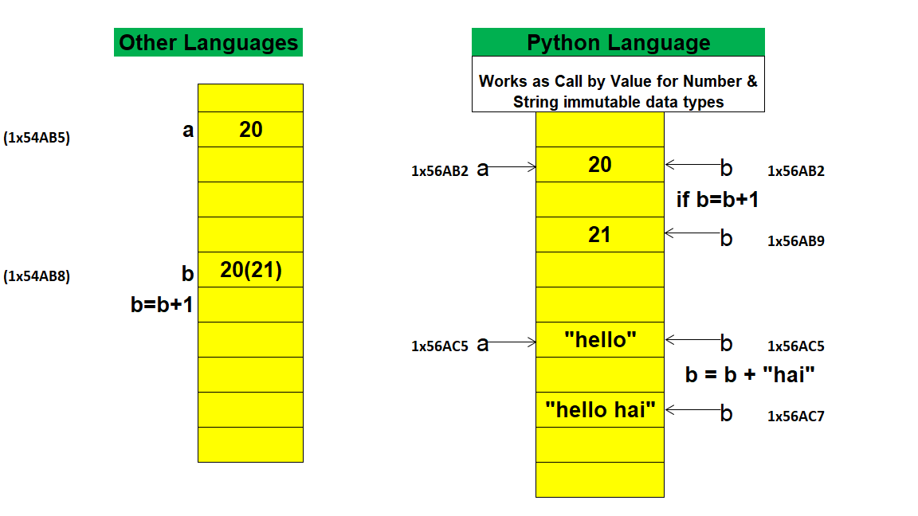
Call by Value :
The Software Services

Slide 152
Call by Reference :
Generally, In Call by Reference method of calling function, the address of the variable value had passed as arguments will be copied to function dummy variables (argument names) any changes to the data will be reflected back to original variable.
In Python, the passed value(object) as argument to a function is pointed by both original variable and dummy variable at the same memory location and if the function try to modify the value(object) then the changes will be made to same memory location and Hence, the original variable will be changed by function modifications.
Python acts as Call by Reference if passed data is Mutable data types like Lists.
The Software Services

Slide 153
Ex:-1
def test(b): # b = [1,2,3]
b.append(4)
print(b)
a = [1,2,3] # list data type mutable
test(a)
print(a)
The Software Services

Slide 154
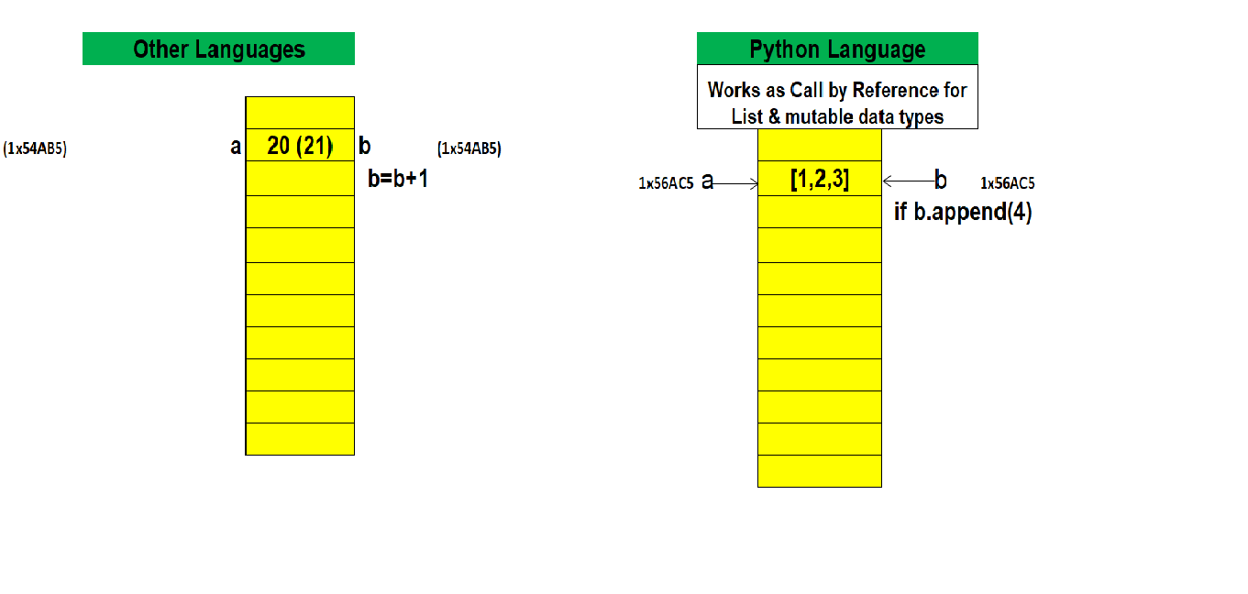
Call by Reference :
The Software Services

Slide 155
Yours !
Veera Raghava
The Software Services

Slide 156
Lambda Functions :
Lambda Functions are Ananomous Functions which doesn’t have a function name. Lambda functions can accept any number of arguments, but they can return only one value in the form of expression.
SYNTAX :
lambda arguments : expression
EX:-1
x = lambda a : a+10
# a is an argument and a+10 is an expression which got evaluated and returned.
print("sum = ",x(20)) # lambda function called with arguments as x(20)
The Software Services

Slide 157
EX:-2
x = lambda a,b:a+b
# a and b are the arguments and a+b is the expression which gets evaluated and # returned.
print("sum = ",x(20,10)) # lambda function called with double arguments as x(20,10)
The Software Services

Slide 158
Yours !
Veera Raghava
The Software Services

Slide 159
List Comprehension :
List Comprehension is technic which is used to create Lists in very compact way.
for item in list:
if condition:
(expression)
Equivalent to
SYNTAX :
[ expression for item in list if conditional ]
Program to print even numbers upto 10.
Ex:1
lst = [ ]
for i in range(10):
if (i%2 == 0):
lst.append(i)
print(lst)
Ex:1
lst = [ i for i in range(10) if (i%2==0) ]
print(lst)
Equivalent to
The Software Services

Slide 160
Program to print squares of numbers upto 10.
Ex:2
lst = [ ]
for i in range(10):
lst.append(i**2)
print(lst)
Ex:2
lst = [ i**2 for i in range(10) ]
print(lst)
Equivalent to
Program to convert small alphabet words into capital words
Ex:3
fruits = ['banana' ,'apple','lime'] cap = [] for i in fruits: cap.append(i.upper()) print(cap)
Ex:3
fruits = ['banana' ,'apple','lime']
cap =[i.upper() for i in fruits ]
print(cap)
Equivalent to
The Software Services

Slide 161
Yours !
Veera Raghava
The Software Services

Slide 162
Programming Exercise :
1. Write a Program to Swap two variables with and without the help of 3rd variable.
2. Write a Program to convert Kilometer into Miles and viceversa
Hint : 1 Mile = 1 Km * 0.62137
3. Write a Program to convert Celsius Temparature into Fahrenheit viceversa
Hint : T(℉) = T(℃) x (1.8) + 32
The Software Services

Slide 163
Programming Exercise :
1. Write a Program to find prime numbers in a interval.
Prime numbers are the numbers that can only be divided by itself or one
2. Write a Program to find factorial of a number.
Ex: 5 , 5x4x3x2x1 = 120
Factorial of zero = 1 (exception)
The Software Services

Slide 164
Programming Exercise :
1. Write a Program to find sum of natural numbers in a interval.
Ex : 1+2+3+4+5+6+7+8+9+10 = sum
2. Write a Program to Fibonacci Sequence.
The Fibonacci sequence specifies a series of numbers where the next number is found by adding up the two numbers just before it.
Ex: 0, 1, 1, 2, 3, 5, 8, 13, 21, 34, so on....
The Software Services

Slide 165
Programming Exercise :
1. Write a Program to sort words in Alphabetic order.
The Software Services

Slide 166
Programming Exercise :
1. Write a Program to all even numbers in a interval.
2. Write a Program to all odd numbers in a interval.
3. Write a Program to sum all the elements of array or list.
The Software Services

Slide 167
Python Basics Syllabus
1. Introduction to Computers | 17. Steps to Develop a Program
2. Python Introduction | 18. Python Decision Making
3. Python Applications | 19. Python IF, IF-ELSE, IF-ELIF-ELSE
4. Python Installation | 20. Python Loops
5. Python IDE PyCharm | 21. Python FOR & WHILE Loops
6. Python Variables | 22. Python BREAK Statement
7. Python Comments | 23. Python CONTINUE Statement
8. Python Data Types | 24. Python PASS Statement
9. Python Operators | 25. Python Functions
10. Python Number Methods | 26. Python Arguments
11. Python String Methods | 27. Python Scope of Variables
12. Python List Methods | 28. Python Call by Value
13. Python Tuple Methods | 29. Python Call by Reference
14. Python Dictionary Methods | 30. Python Lambda Functions
15. Python Set Methods | 31. Python List Comprehension
16. Python Nesting of Sequences | 32. Python Programming Exercise
The Software Services

Slide 168
The Software Services

Slide 169
The Software Services

Slide 170
The Software Services

Slide 171
The Software Services

Slide 172
The Software Services

Slide 173
The Software Services

Slide 174
The Software Services

Slide 175
The Software Services

Slide 176
The Software Services

Slide 177
The Software Services

